Slide 1
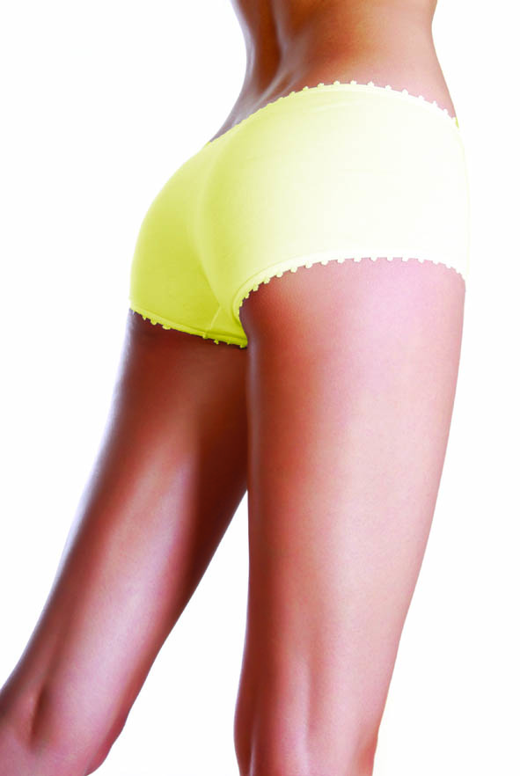
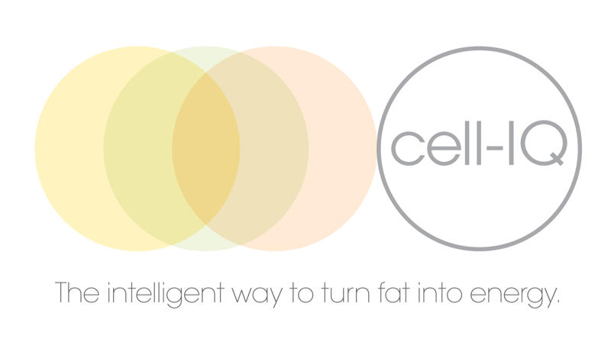
Welcome to cell-IQ™

Slide 2
What is cell-IQ™?
Cold Low-Level laser treatment for fat reduction.
Reduces fat on trouble spots and stubborn areas.
The smart alternative to surgery.
Pain free, non-invasive and safe.
Notes:
Focuses Adipose tissue – fat cells
Everyone has

Slide 3
What Is Low-Level laser?
Cold Laser Technology shown to emulsify fat
Originally used to assist tumescent liposuction but found that the cold laser alone helped patients reduce inches from waist, hips and thighs
Very safe, the technology has been studied and used for 30 years
Does not alter or effect the skin, blood vessels or nerves
Laser light only penetrates 1 cm deep and no adverse effects have ever been recorded

Slide 4
How does cell-IQ™ work?
REMOVES THE FAT Low-Level Laser energy
disrupts fat cell, removing its contents
MOVES THE FAT Stimulates the Lymphatic system to mobilise this fat
GETS RID OF THE FAT Exercise Post Treatment ‘Burns Off’ this Fat.
Results can be seen immediately with a 30% reduction in the fat layer and 5-10cm in abdominal circumference after just one treatment

Slide 5
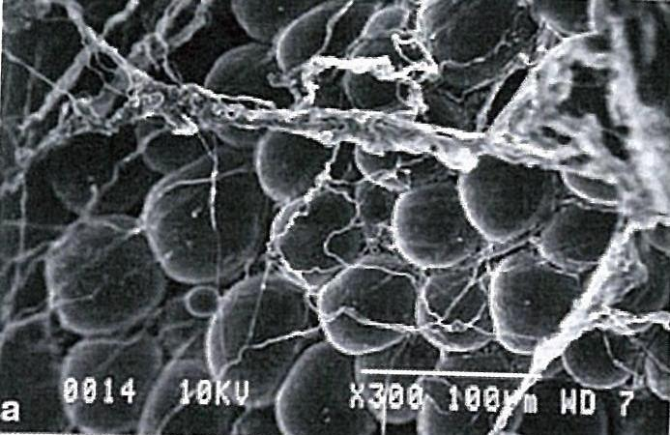
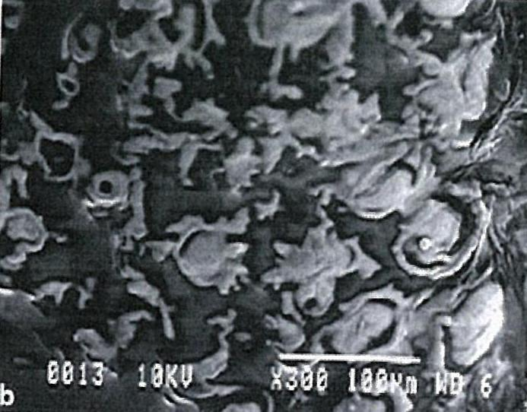
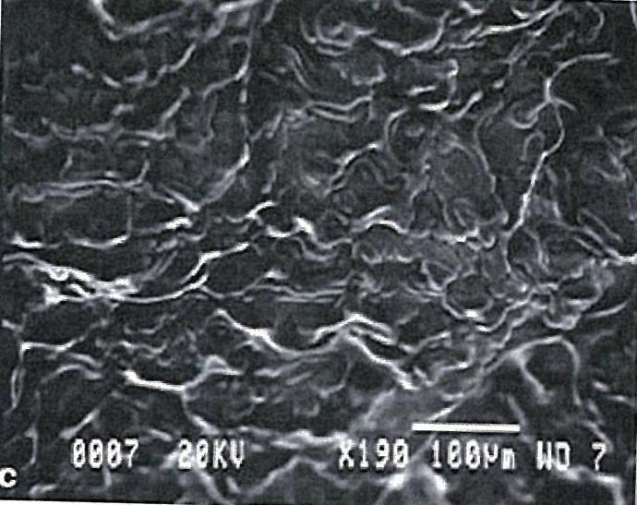
a) Round adipose cells with the surrounding connective tissue
b) At 4 minutes of laser exposure, 80% of the fat is seen coming out of the adipose cell through a disrupted membrane
c) At 6 minutes of laser exposure, the fat is almost completely 100% liquefied outside the cell

Slide 6
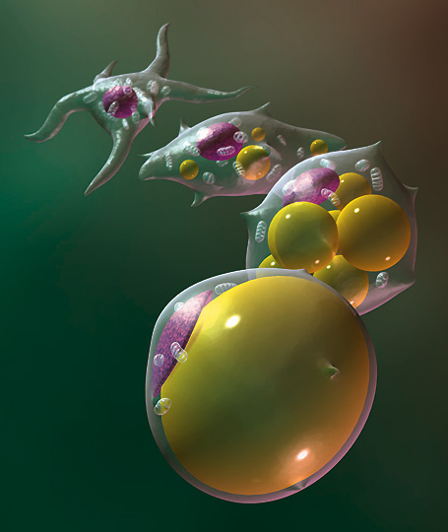
What is Adipose Tissue?
Adipose tissue = fat cells
Each individual has 20-40 billion fat cells
Average size 0.1mm
Can expand 4X

Slide 7
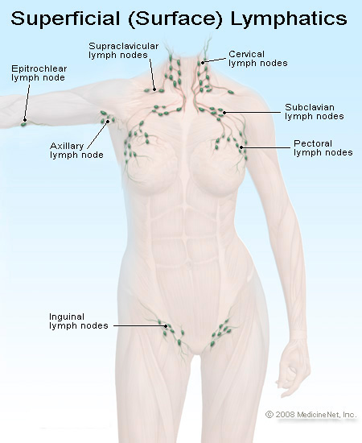
What are Lymph Nodes?
Bean-shaped bumps, a few mm to 1-2cm in size.
We have approx 500-600 nodes located in clusters in the underarms, groin, neck, chest and abdomen.
What do they do?
Act as filters for foreign particles and are part of the bodies immune system.
Disposes waste and toxins through bladder, bowel, lungs and skin.
Why are they important?
Stimulation of nodes enhances activity of lymphatic flow system to remove fat freed from the cells during treatment.
A healthy lymphatic system will increase results.

Slide 8
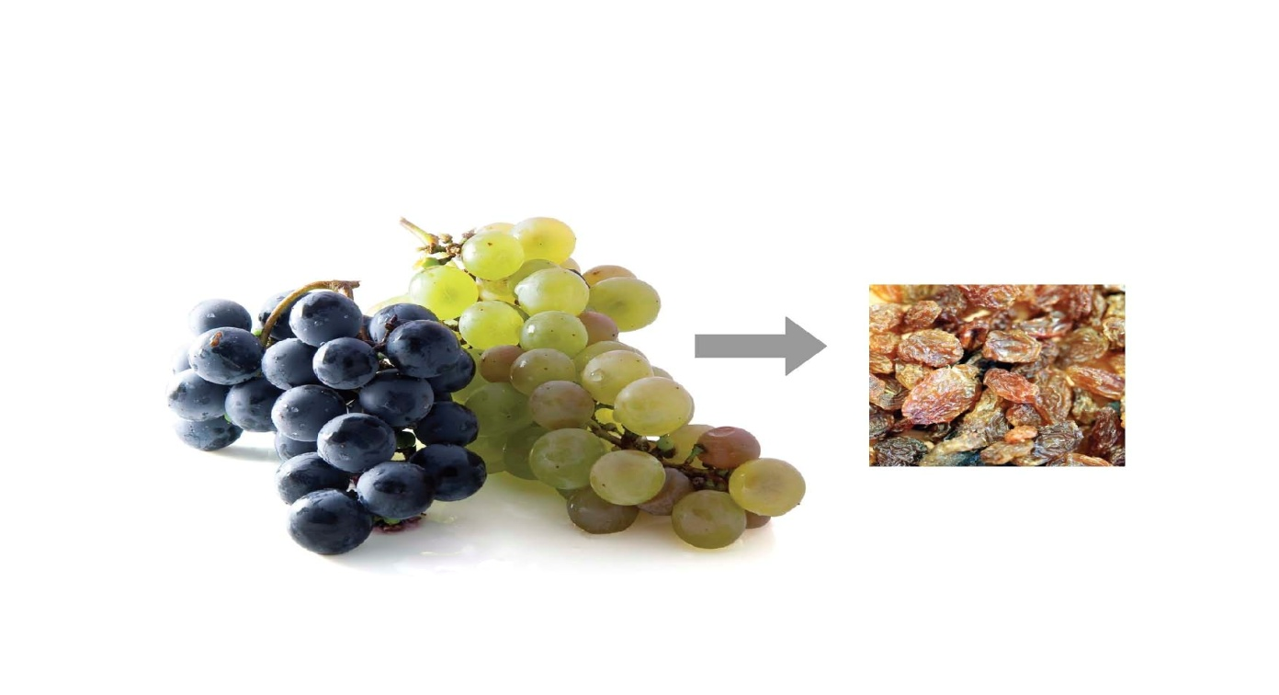
From Grapes to Raisins
Imagine the fat cell as a plump grape, after 6 minutes of the laser energy penetrating the fat cell, the cell then loses its shape (shrinking to a raisin) releasing the fatty fluid into your system.
The empty cells are still there, just taking up less space.
In the future, they can be filled up again if the body has excess calories from food.

Slide 9
Treatment Benefits
Fast treatment time
Fast results
Immediate results from one off session
Course of 8 sessions will provide continual centimetre loss
Selective targeting of ‘problem areas’.

Slide 10
What can I expect?
Typical loss over 8 treatments is 5-10 cm (per measurement).
Very dependant on depth of fat layer, diet and lifestyle.
Will I need future treatments?
Once fat is removed, it will only return if the calories in exceeds calories out.
Occasional or regular one off treatments can be scheduled to counter act diet blips.
How long will my treatments last?
Simple maths, calories in = calories out.
Once you buy a fat cell its yours to keep.

Slide 11
The Perfect Client
Someone who has made decision to improve overall diet and exercise regime and wants help to reduce up to 1-2 dress sizes in an anatomical location.
Someone who wants quick results to provide motivation for them to carry on.
Someone who wants quick results for a special event.
Someone who wants to target specific ‘resistant’ areas that haven’t changed despite regular gym usage.

Slide 12
Contraindications
Please see example of medical form
Some contraindications require Doctor’s Consent to have treatment
Pregnancy
Epilepsy
Persons under 18 years old
Thyroid Gland Dysfunctions
Type 1 IDDM, Type 2 NIDDM
Cardio Vascular conditions
Pacemakers
Cancer
Disease/Infection
Liver/Kidney Disease
Metal Pins/Plates/Cosmetic Implants
Auto Immune Disease
Medical Odema- swelling of the lymphatic system
Gastric Ulcers
HIV
Muscular/Skeletal Problems

Slide 13
Treatment schedule
Course of 8 sessions
Treatment twice weekly
Treatment time 30 minutes (3 X 6 minute irradiation )
Cardiovascular exercise – must be performed as soon as possible after treatment

Slide 14
Pre-treatment
AVOID:
A heavy meal in the two hours before and after treatment as this will confuse the body as to which ‘fat’ to metabolise.
Coffee, tea or carbonated drinks prior to a treatment as these may cause bloating. (Good hydration provides a healthy lymphatic system.)
Treatment around menstruation – can impair measurements if on first/last treatment.

Slide 15
Post-treatment
cell-IQ™ treatment will achieve centimetre loss.
cell-IQ™ does not remove fat cells or the ability to store fat.
This is GOOD, since removing the ability to store fat here will make the body seek out other areas to store vital energy, such as the major organs or arteries.
Diet and exercise are crucial to retain results in the future.
Healthy lymphatic system and cells increase results.

Slide 16
What sort of exercise?
30 minutes of cardiovascular exercise - first 20 minutes metabolises ‘quick’ energy stored as glycogen. -final 10 minutes metabolises other sources including that mobilised by cell-IQ™.
Needs to be sustained at a ‘fat burning‘ rate that speeds up metabolic rate and ‘uses up’ mobilised fat.
Cardio exercise prevents the fat being re-stored.

Slide 17
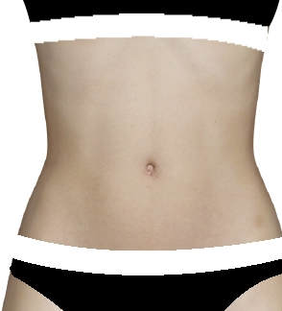
Measuring your client
Measurements are taken in 3 places over the treatment area:
1st pad position
2nd pad position
3rd pad position
2.5cm to 10cm according to treated zone

Slide 18
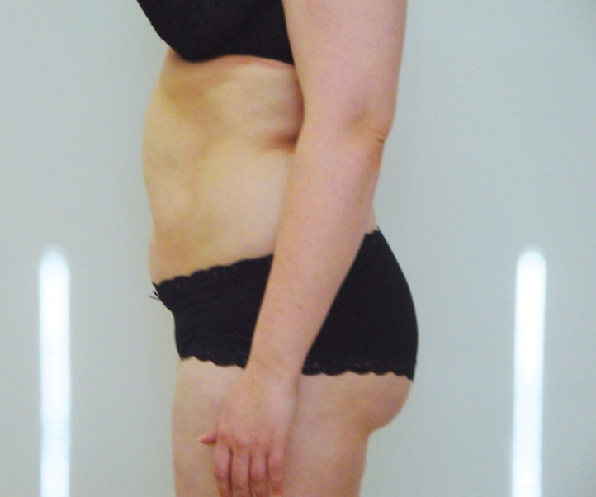
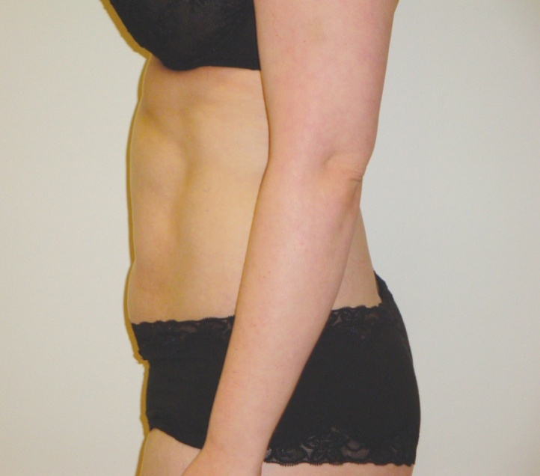
Results
Before
After
Loss of 3 inches and 1 dress size

Slide 19
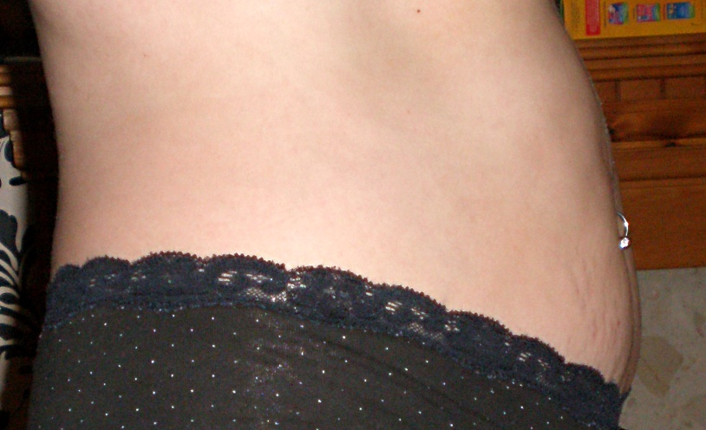
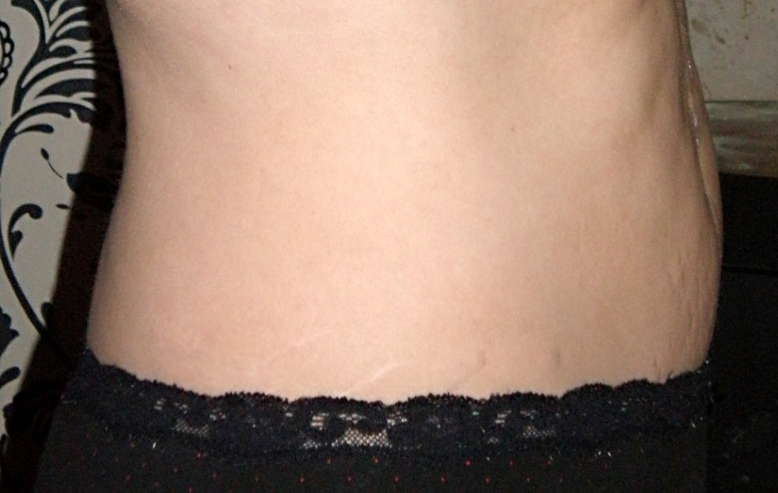
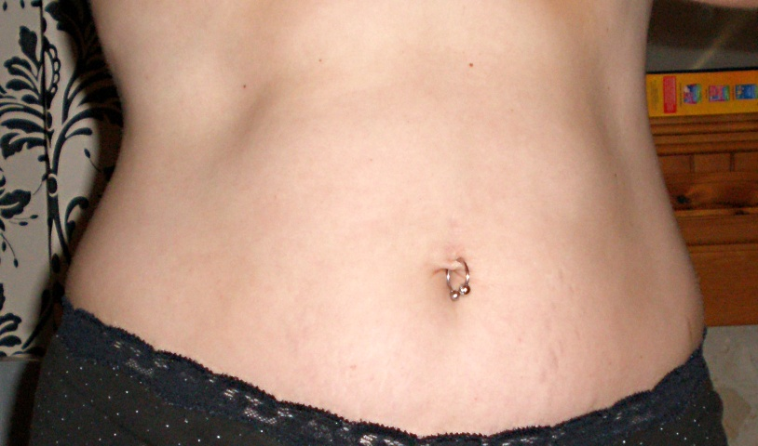
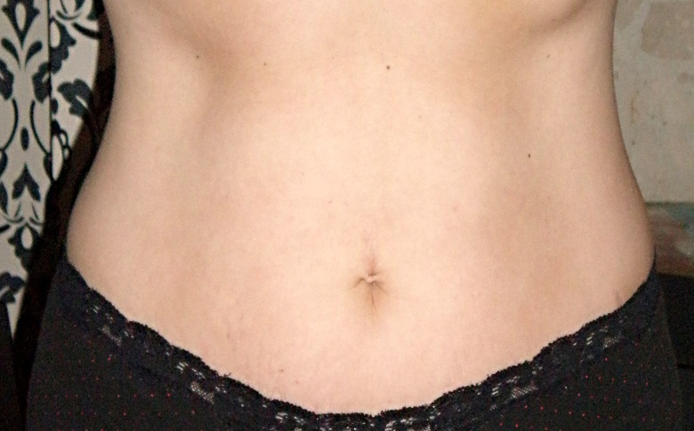
Before
After

Slide 20
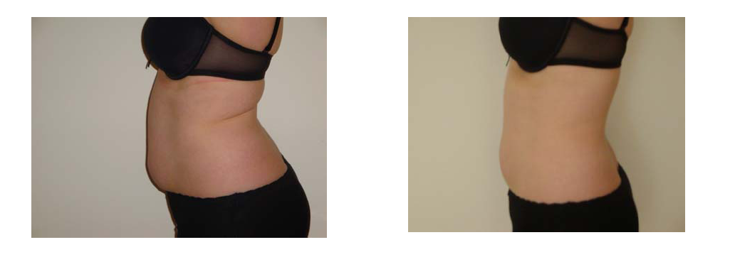
Before and After 8 treatments
Total inch loss: 12.6 inches

Slide 21
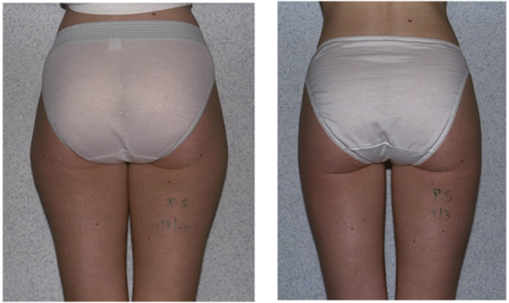
Before
Thigh Size : 65 cm
After
Thigh Size : 58cm

Slide 22
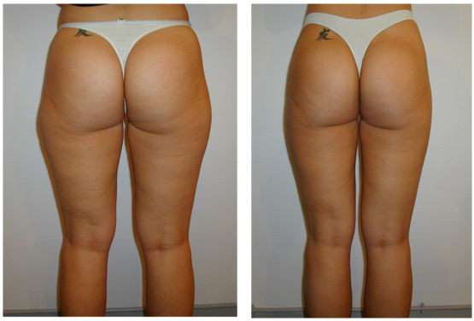
Before
Thigh Size : 75 cm
After
Thigh Size : 63cm

